Slide 1
COMPUTER SIMULATION · NO PRACTICAL EXPERIMENTS
V-Guard Sentinel
A simulation-backed design for an offline AI core that gives the home inverter a battery-health estimate, safe load control, appliance insight, and a path to fleet learning.
Team Codey Tingle (TI3271) · Ayush Manoj Garg · Eshan Shukla · Tanay ChaplotReport ↔ prototype reconciliation · September 2026
V-Guard Sentinel · Team Codey Tingle (TI3271) · computer simulation only
1

Slide 2
DESIGN CONTEXT
The battery is the silent point of failure
The report establishes the opportunity; the prototype tests the logic with simulated data.
▪ an inverter can switch quickly but usually cannot estimate how its battery is ageing.Problem:
▪ an unexpected battery failure interrupts food storage, work, study, connectivity, and medical loads.Cost:
▪ turn existing voltage, current, temperature, and load signals into an offline decision layer.Opportunity:
V-Guard Sentinel · Team Codey Tingle (TI3271) · computer simulation only
2

Slide 3
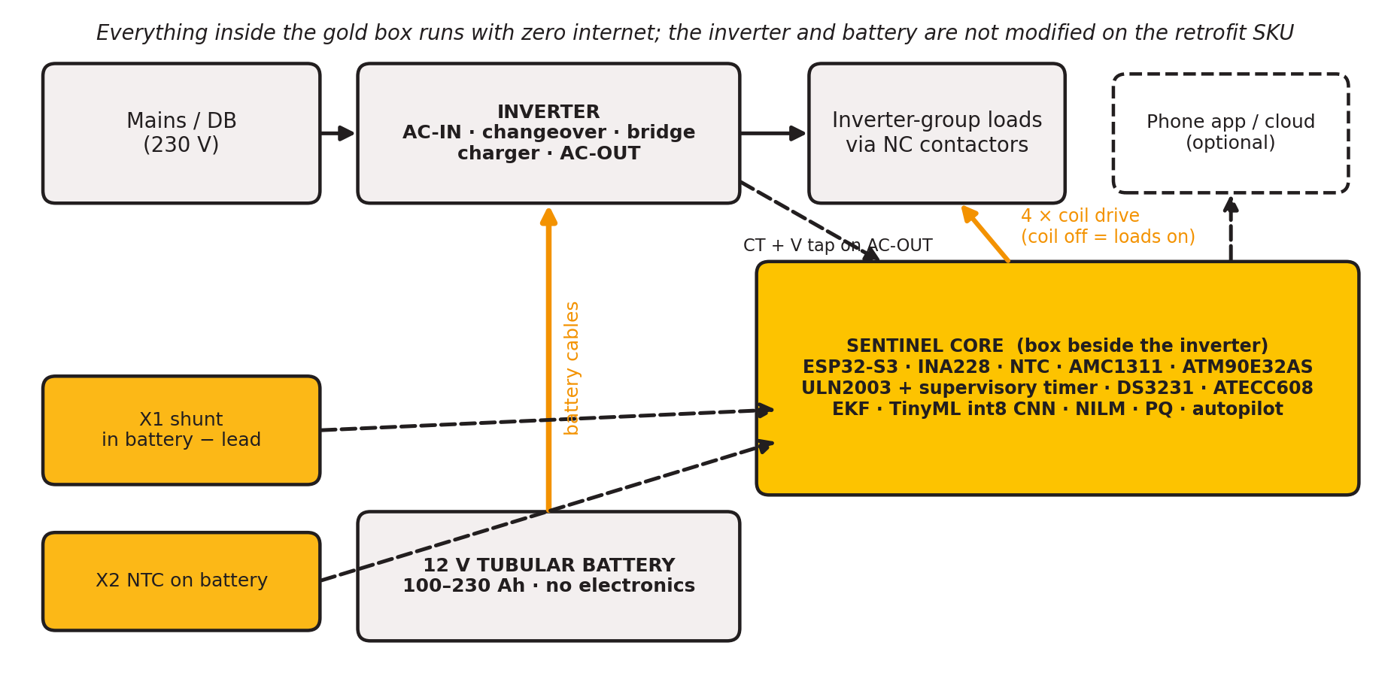
SYSTEM BOUNDARY
What Sentinel is — and what it is not
A proposed signal-and-control module beside an inverter, with optional cloud services.
the battery current stays in an external shunt or Hall sensor. The module reads a signal, watches inverter AC output through a metering path, and drives external contactors. The battery and inverter have not been physically modified or tested in this project.Retrofit reality:
V-Guard Sentinel · Team Codey Tingle (TI3271) · computer simulation only
3

Slide 4
SIMULATED ARCHITECTURE
Four engines, one proposed core
The prototype implements host-side algorithms and replay paths; hardware integration remains a future gate.
1 · Battery health
2 · Autopilot
3 · Energy Coach / Grid Shield
4 · Fleet learning
EKF plus a small int8 CNN estimates SoH/RUL bands from synthetic cycle features. A warning is a window, never a date.
Deterministic tiers and hysteresis protect essentials. The current prototype evaluates the controller in scripted scenarios.
NILM and power-quality code consume synthetic AC streams. A metering AFE is designed but not bench-validated.
Central-learning telemetry is designed. Flower/Secure Aggregation/DP are specified but deliberately deferred from this prototype.
V-Guard Sentinel · Team Codey Tingle (TI3271) · computer simulation only
4

Slide 5
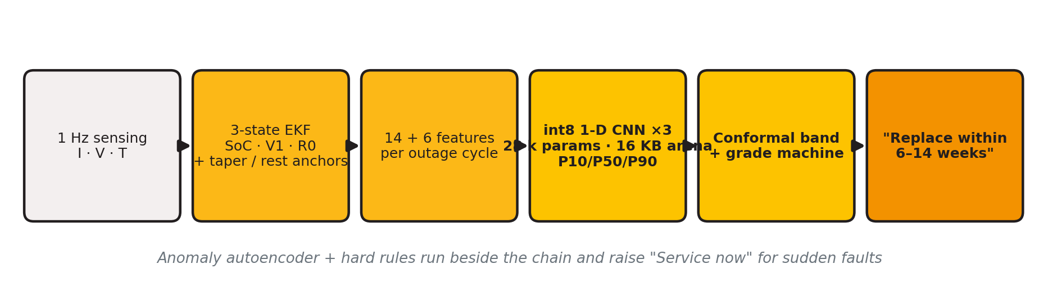
HOST-SIDE MODEL PIPELINE
Engine 1 · From simulated signals to a health band
Physics first, learning second.
▪ simulated 1 Hz I/V/T streams reduced to 14 dynamic and 6 static features per cycle.Inputs:
▪ 1-D CNN, three seeds, quantile heads, conformal calibration, and a grade state machine.Model:
▪ real tubular-battery ageing labels and ESP32-S3 execution.Pending:
V-Guard Sentinel · Team Codey Tingle (TI3271) · computer simulation only
5

Slide 6
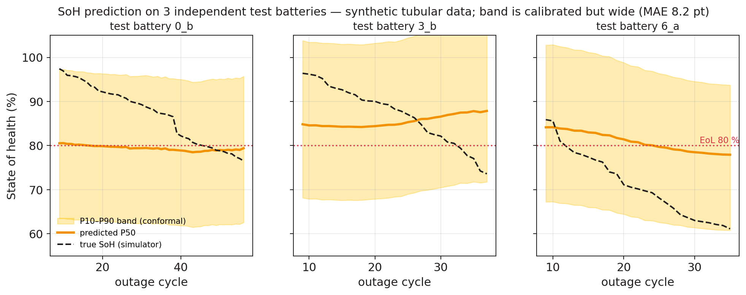
SYNTHETIC DATA ONLY
Engine 1 · What the current artifacts show
These are computer-simulation results, not practical experiments or field accuracy.
SoH MAE / RMSE8.2 / 9.6 percentage points16 simulated batteries; 3 final-test batteries
80% coverage0.66 → 0.99 after conformalpost-calibration band is very wide: MPIW 34 points
RUL window hit rate1.00 (n = 3)too small to support a product claim
int8 delta+0.01 point MAEhost/reference comparison; silicon not tested
V-Guard Sentinel · Team Codey Tingle (TI3271) · computer simulation only
6

Slide 7
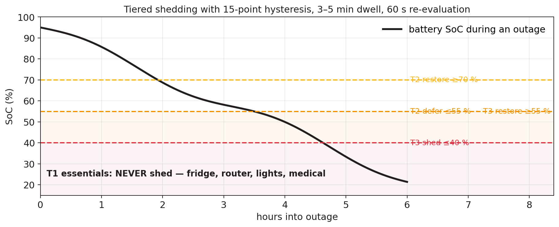
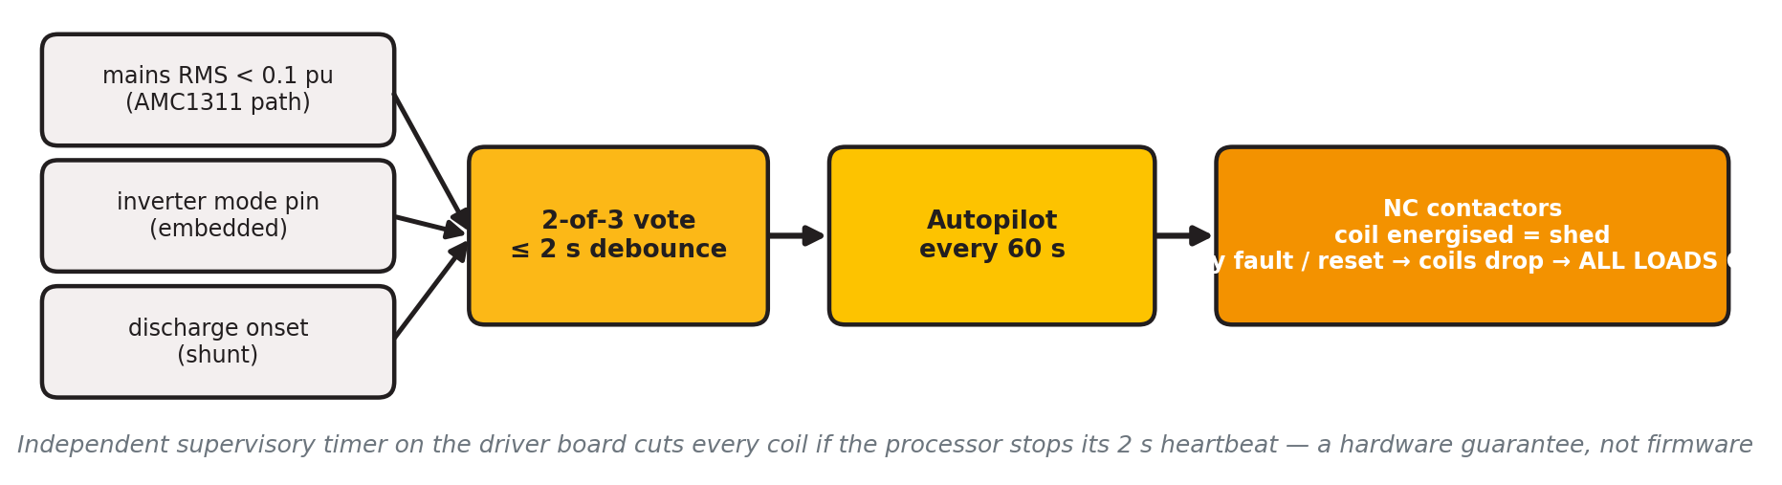
CONTROLLER SIMULATION
Engine 2 · Autopilot protects essentials
The safety logic is deterministic; the load/outage tables are transparent and replayable.
▪ T1 essentials stay on.
▪ T2 defer at 55%; restore at 70%.
▪ T3 shed at 40%; restore at 55%.
▪ Hysteresis and dwell timers prevent chatter.
V-Guard Sentinel · Team Codey Tingle (TI3271) · computer simulation only
7

Slide 8
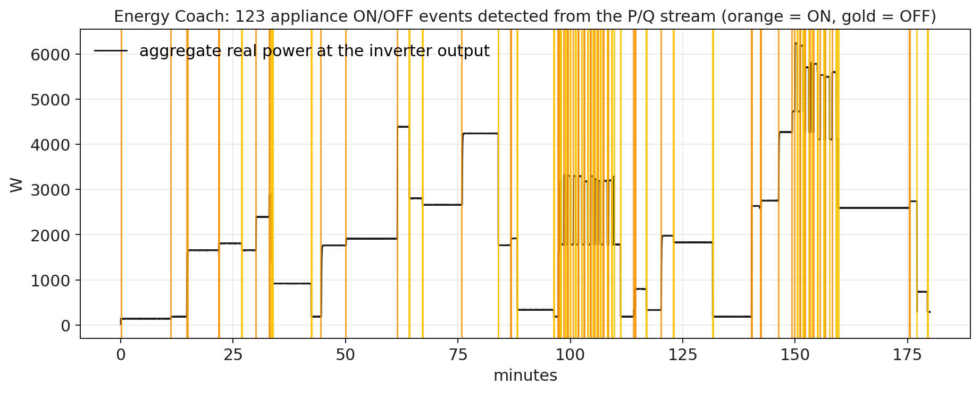
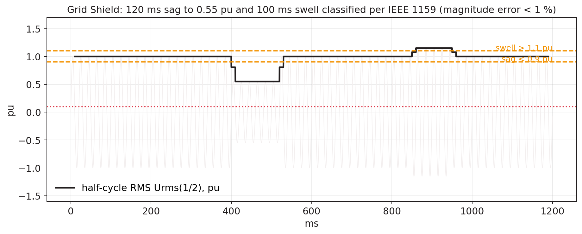
SYNTHETIC STREAMS
Engine 3 · Coach and Grid Shield
The repository corrects an important report gap: NILM needs AC output metering, not only battery DC current.
▪ Event detector and appliance matching run on simulated P/Q streams.
▪ Scope is directional: large loads and per-home calibration.
▪ Half-cycle RMS and FFT logic classify simulated sags, swells, and THD.
▪ AFE, CTs, reference meter, and live AC waveform capture remain unbuilt.
V-Guard Sentinel · Team Codey Tingle (TI3271) · computer simulation only
8

Slide 9
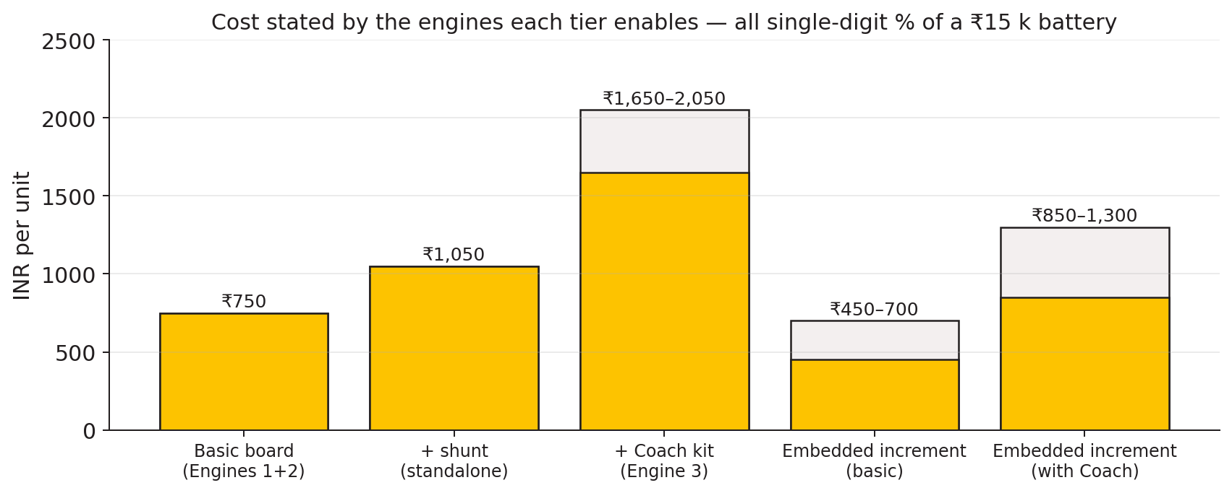
DESIGN + COST MODEL
Two SKUs keep the claims honest
The report’s original universal adaptive-charging claim was narrowed in the prototype design register.
Embedded
Designed for a compatible new inverter. Charger control and any life-extension claim belong here, subject to ageing-campaign evidence.
Retrofit
External shunt, AC metering path, contactors, and advisory charging. It cannot command an unknown analogue charger.
V-Guard Sentinel · Team Codey Tingle (TI3271) · computer simulation only
9

Slide 10
REPOSITORY IMPLEMENTATION
What is implemented in software
A runnable host prototype, not a deployed product.
▪ 1 Hz synthetic tubular duty-cycle simulator and feature extraction.
▪ EKF, autopilot, NILM, PQ, charging policy, and health-log reference implementations.
▪ Three-seed int8/TFLite export artifacts and a C golden self-test.
▪ Dashboard fixture and file providers with provenance labels.
▪ Host firmware links the real C control modules against replayed CSV data.
▪ NASA/CALCE loaders and Stage A/B/C scaffolding exist, but real-source training is incomplete.
▪ Hardware tests, ESP-IDF build, sensor drivers, and ATECC608 provisioning remain open.
this deck reports repository artifacts and documented runs. It does not present them as practical experiments.Verification note:
V-Guard Sentinel · Team Codey Tingle (TI3271) · computer simulation only
10

Slide 11
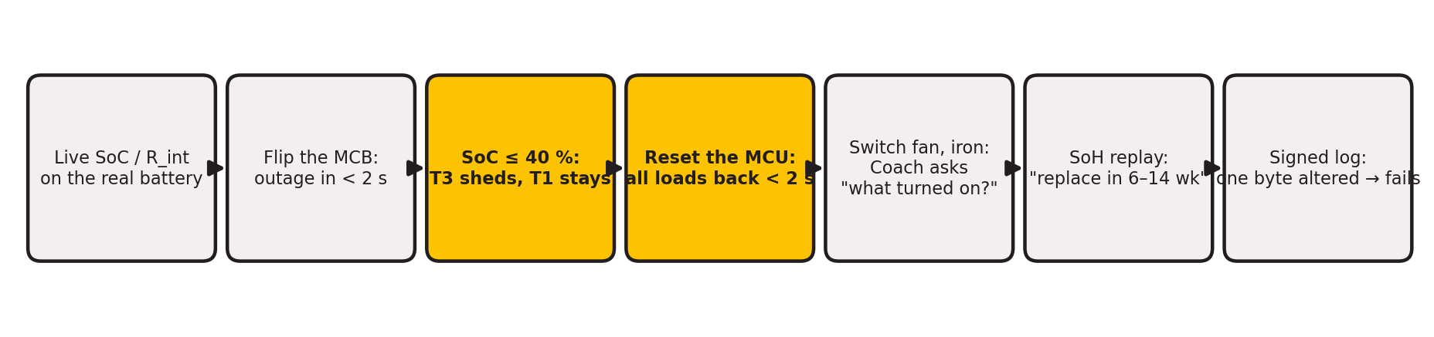
COMPUTER-ONLY WALKTHROUGH
How one simulated outage moves through the system
This is the main prototype story: the same event flows from generated data to a dashboard decision.
V-Guard Sentinel · Team Codey Tingle (TI3271) · computer simulation only
11

Slide 12
FLEET SIMULATION · NOT DEPLOYED HOMES
Cluster-of-homes view: central learning path
A conceptual fleet view for the prototype story — these homes are simulated clients, not installed units.
V-Guard central training
consented summaries
V-Guard central training
consented summaries
Home A
synthetic
→
Home B
synthetic
→
Home C
synthetic
→
→
What is simulated
What is not claimed
Federated status
Different household duty cycles, temperatures, loads, and battery trajectories.
No live homes, no field telemetry, no deployed fleet, and no measured privacy budget.
Flower, Secure Aggregation, and DP-FTRL are designed but deliberately deferred from this prototype.
V-Guard Sentinel · Team Codey Tingle (TI3271) · computer simulation only
12

Slide 13
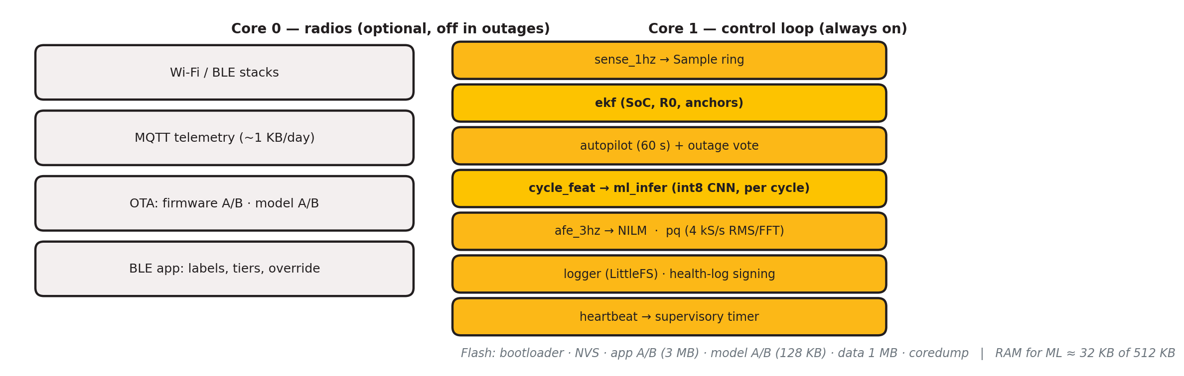
FIRMWARE DESIGN; HOST-ONLY EXECUTION
Self-contained by construction — on paper and in replay
No cloud is required by the algorithm path; the physical firmware target is still unverified.
host C build, replayed CSV, int8 golden self-test, and dashboard JSON. ESP-IDF compilation, flashing, real-time timing, power measurement, sensor drivers, secure boot, and hardware fault injection.Current evidence:Pending:
V-Guard Sentinel · Team Codey Tingle (TI3271) · computer simulation only
13

Slide 14
REPORT ↔ PROTOTYPE RECONCILIATION
Corrections made after engineering review
The prototype documentation is more conservative than the frozen submission report.
OCV correction
Signal boundary
Charging boundary
Model boundary
Float voltage is not open-circuit voltage. Use charge-current taper and true charger-off rest.
A battery shunt cannot disaggregate AC appliances. Add an AC metering front end and CT path.
Adaptive charging is embedded-SKU only; retrofit is advisory unless a verified charger interface exists.
Real tubular accuracy waits for the ageing campaign. Synthetic metrics are pipeline evidence only.
Federated boundary
Terminology
Central summaries are the current path. Federated learning is specified, not demonstrated.
ESP32-S3 vector/SIMD extensions and milliamp-class draw replace “neural accelerator” and “microamp” wording.
V-Guard Sentinel · Team Codey Tingle (TI3271) · computer simulation only
14

Slide 15
NEXT VALIDATION GATES
What must happen before product claims
The roadmap is deliberately gated by evidence rather than calendar promises.
Gate 1 · Tubular data
Gate 2 · Bench hardware
Gate 3 · Field pilot
Age 24–36 representative batteries across temperature, depth of discharge, and charge regime. Establish real SoH labels and estimator tables.
Build the sensor/AFE/contactor path, compile ESP-IDF, flash the ESP32-S3, and measure timing, draw, fail-safe behaviour, and PQ/NILM against reference instruments.
Run monitored units, validate warnings against actual replacements, and only then quantify life extension, backup gains, warranty savings, or fleet learning.
V-Guard Sentinel · Team Codey Tingle (TI3271) · computer simulation only
15

Slide 16
FINAL STATUS · COMPUTER SIMULATION
A credible prototype starts by saying exactly what it has not tested.
The repository demonstrates the algorithms, replay path, host firmware, dashboard, and evidence boundaries. Real batteries, real homes, real ESP32 hardware, and field experiments are the next gates.
V-Guard Sentinel · Team Codey Tingle (TI3271)github.com/epshukla/vguard-sentinel
V-Guard Sentinel · Team Codey Tingle (TI3271) · computer simulation only
16

